Slide 1


Project Probability_Medical Insurance
Probability Course - Sekolah Data Pacmann
pacmann.io
© 2022 – Pacmann AI

Slide 2
Outline
Introduction
Dataset
Descriptive Statistic Analysis
Categorical Variables Analysis
Continuous Variables Analysis
Variables Correlation
Hypothesis Testing
Conclusion

Slide 3
Introduction
Notes:
Transisi antar outline

Slide 4
Introduction
One of the purposes of health insurance is for future planning needs.
In its implementation, health insurance users must pay regular amounts of money (insurance premiums) to the insurance company.
The insurance company processes the insurance premiums to pay the user's health bill.
Determining the value of insurance premiums is challenging because many factors can influence and increase users' risk profiles.
The following analysis aims to determine certain conditions of health insurance users that can affect health charges.

Slide 5
Dataset
Notes:
Transisi antar outline

Slide 6
Dataset
Dataset: Personal health charges data
Dataset contains seven variables.
age : age of primary beneﬁciary
sex : Insurance contractor gender, female, male
bmi : Body mass index, providing an understanding of body, weights that are relatively high or low relative to height, objective index of body weight (kg/m) using the ratio of height to weight
children : Number of children covered by health insurance / Number of dependents
smoker : Smoking
region : The beneﬁciary's residential area in the US, northeast, southeast, southwest, northwest.
charges : Individual medical costs billed by health insurance

Slide 7
Descriptive Statistics Analysis
Notes:
Transisi antar outline

Slide 8
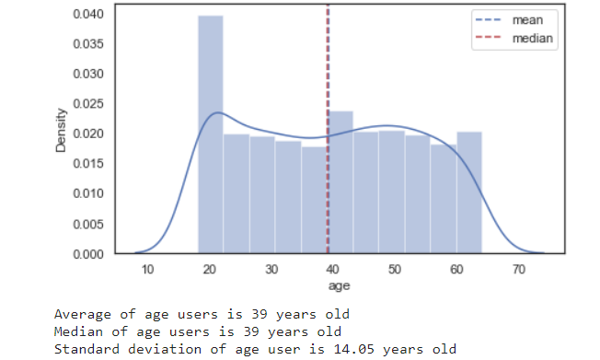
Mean and Median of Age
This section shows the age distribution plot of insurance users, with additional information such as mean, median, and standard deviation.
Generally, the user age of primary beneﬁciary is very diverse
The average user age of primary beneﬁciary is 39 years with 14 years standard deviation

Slide 9
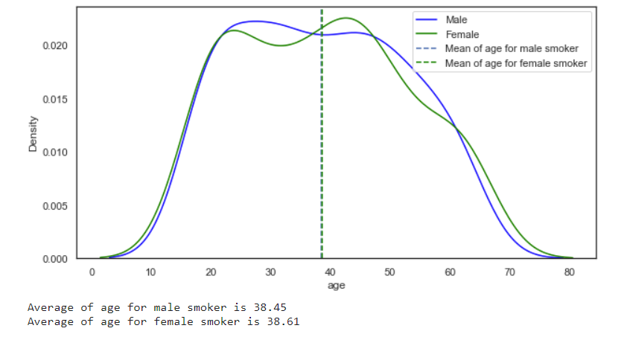
Mean, Standard Deviation of Age of Smoker by Gender
This section shows the ages distribution plot of insurance by gender, with additional information such as mean, and standard deviation.
The average age of female and male users who smoke is almost the same, 38 years old.

Slide 10
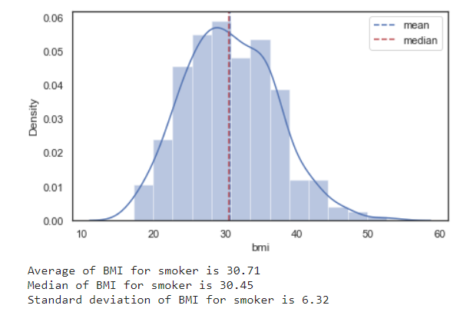
Mean of BMI
This section shows the BMI distribution plot of insurance users, with additional information such as mean, median, and standard deviation.
The average body mass index of smoking user is 30,71.
Ideal index of BMI is 18,5 to 24,9. The average BMI index of smoking users is Overweight, because it exceeds the ideal index limit and more than 30. (https://www.cdc.gov/healthyweight/assessing/bmi/adult_bmi/index.html)

Slide 11
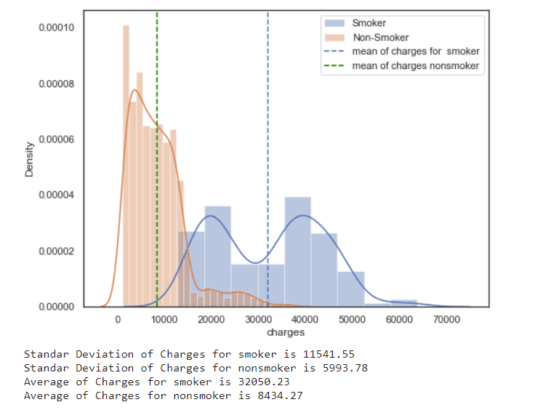
Mean, Standard Deviation of Charges
This section shows the charges distribution plot of insurance users for Smoker and NonSmoker, with additional information such as mean, and standard deviation.
Average charges of smoking users are greater than nonsmokers
However, the charges of smoking users are more varied than nonsmokers

Slide 12
Analysis
Generally, the user age of primary beneﬁciary from data personal health charges is very diverse. The average user age of primary beneﬁciary is 39 years with 14 years standard deviation. However, the average age of female and male users who smoke is almost the same, 38 years old.
Interestingly, The average body mass index of the smoking user is 30,71. based on information from CDC, the Ideal index of BMI is 18,5 to 24,9, thus the average BMI index of smoking users is overweight because it exceeds the ideal index limit and more than 30.
As a result, the average charges of smoking users are greater than nonsmokers with an average of $32.000, 23 for smoking users, and $8434,27 for nonsmoking users. These two numbers have a huge difference. However, the charges of smoking users are more varied than nonsmokers.

Slide 13
Categorical Variables Analysis
Notes:
Transisi antar outline

Slide 14
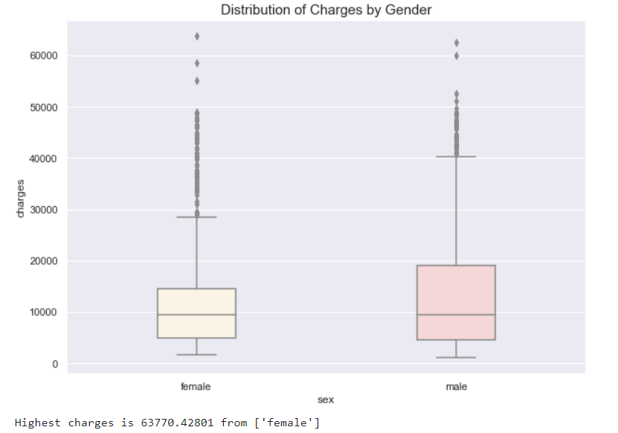
Distribution of charges by gender
This section shows the distribution of charges by gender.
The charges from female users are higher than male charges

Slide 15
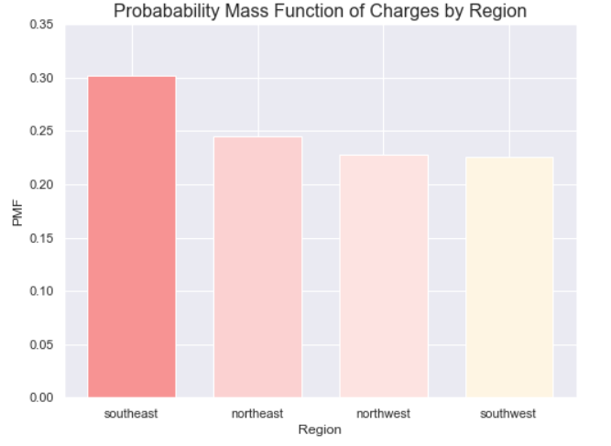
Probability Mass Function of Charges by Region
This section shows Probability Mass Function of Charges by Region
Southeast region has the highest probability mass function while southwest region has the lowest probability mass function. However, northwest region has similar PMF with southwest region.

Slide 16
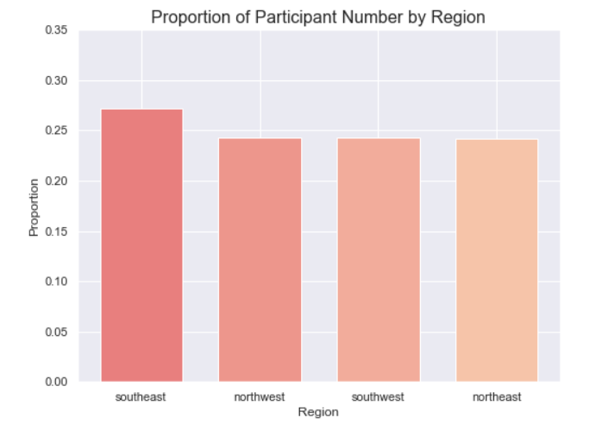
Proportion of Participants Number by Region
This section shows Proportion of Participants Number by Region
The Southeast region has the highest proportion of participants while the others have almost the same proportion.

Slide 17
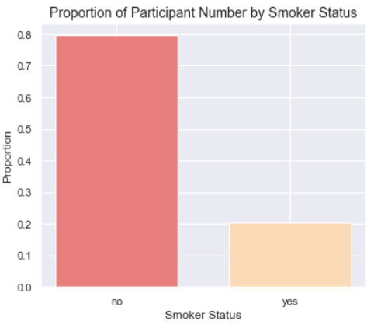
Proportion of Participant Number by Smoker Status
This section shows Proportion of Participant Number by Smoker Status
Non-smoker users have a higher proportion of participant number than smoker users.

Slide 18
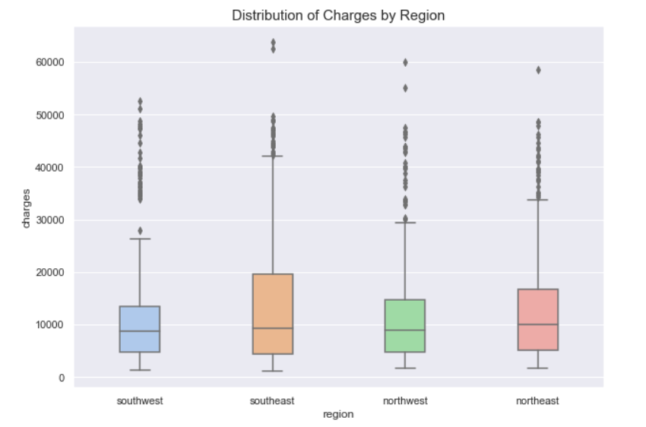
Distribution of charges by region
This section shows distribution of charges by region
The Southeast region has a more diverse distribution of charges compared to other regions. Some users have charges exceeding $60,000. However, other regions also contain a variety of charge distributions.

Slide 19
Analysis
The charges of female users from data personal health charges are higher than male charges. Based on region, The Southeast region has the highest proportion of participants while the others have almost the same proportion.
The Southeast region has a more diverse distribution of charges compared to other regions. Some users have charges exceeding $60,000. However, other regions also contain a variety of charge distributions. One of the factors that may be related to these charges is smoker status. Based on smoker status, non-smoker users have a higher proportion of participant number than smoker users.

Slide 20
Continuous Variables Analysis
Notes:
Transisi antar outline

Slide 21
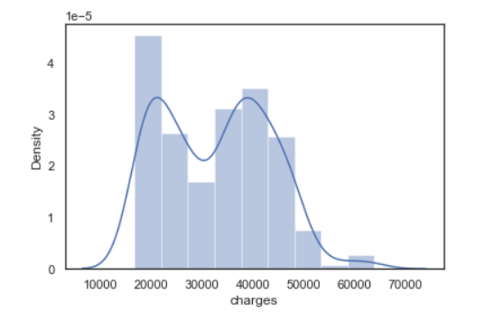
Density of someone has charges > 16.700 given he has BMI > 25
This section shows density plot of someone has charges > 16.700 given he has BMI > 25

Slide 22
Probability of someone has charges > 16.700 given BMI and Smoker Condition
This section shows probability of :
Someone has charges > 16.700 given he has BMI > 25
Someone has charges > 16.700 given he’s smoker
Results:
Probability of someone has charges > 16.700 given BMI> 25 is 0,259
Someone with BMI more than 25 has a small possibility to get high charges
Someone has charges > 16.700 given he’s smoker is 0,927
Someone with BMI more than 25 has a high possibility to get high charges

Slide 23
Probability of someone has charges > 16.700 given BMI > 25 Vs Probability of someone has charges > 16.700 given BMI < 25
This section shows probability of :
Someone has charges > 16.700 given he has BMI > 25
Someone has charges > 16.700 given he has BMI < 25
Results:
Probability of someone has charges > 16.700 given BMI> 25 is 0,259
Probability of Someone has charges > 16.700 given BMI< 25 is 0,206
Someone with BMI more than 25 has higher possibility to get high charges,
even though both of them have a small chance to get high charges

Slide 24
Probability of someone has charges > 16.700 given smoker with BMI > 25 Vs Probability of someone has charges > 16.700 given nonsmoker with BMI > 25
This section shows probability of :
Someone has charges > 16.700 given smoker with BMI > 25
Someone has charges > 16.700 given nonsmoker with BMI > 25
Results:
Probability of someone has charges > 16.700 given smoker with BMI > 25 is 0,981
Probability of Someone has charges > 16.700 given nonsmoker with BMI> 25 is 0,077
Smoker with BMI more than 25 has higher possibility to get high charges, with a very high possibility to get high charges

Slide 25
Variables Correlation
Notes:
Transisi antar outline

Slide 26
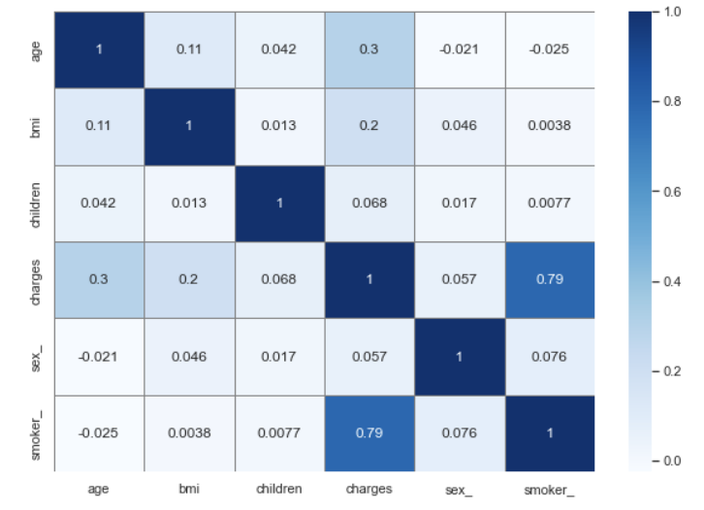
Correlation
This section shows correlation plot of Personal health charges data variables
Method : Pearson Correlation
Smoker status has the highest correlation with charges variables with coef 0.79. It means that There is a strong positive relationship between those two variables
There is a unidirectional relationship between the variable charges and the smoker. This means that if the number of smoking users increases, the charges will also increase.
Another variable that has a relationship with the charges variable is age, however the relationship is weak with a correlation coef. value of 0.3.
This means that if the age increases, the charges will also increase.

Slide 27
Hypothesis Testing
Notes:
Transisi antar outline

Slide 28
Smoker’s charges are higher than non-smoker’s
This section shows hypothesis test of smoker’s charges and non-smoker’s charges using Unequal Variance T-Test
hypothesis:
H₀ : Smokers charges <= non-smoker
H₁ : Smokers charges > non-smoker
Alpha : 0.05
Result
P-value : 0.00< 0.05, Failed to reject Ho
Smokers charges are higher than non-smokers

Slide 29
Is there any different between male and female BMI ?
This section shows hypothesis test of male BMI and female BMI using Unequal Variance T-Test
hypothesis:
H₀ : Male BMI = Female BMI
H₁ : Male BMI ≠ Female BMI
Alpha : 0.05
Result
P-value : 0.00< 0.05, Failed to reject Ho
Male BMI and female BMI are the same

Slide 30
Is the charges of user with BMI more than 25 higher than the charges user with BMI less than 25??
This section shows hypothesis test of charges of user with BMI more than 25 higher than the charges user with BMI less than 25 using Proportion Beetween 2 Sample test.
hypothesis:
H₀ : Charges of user with BMI more than 25 <= charges user with BMI less than 25
H₁ : Charges of user with BMI more than 25 > charges user with BMI less than 25
Alpha : 0.05
Result
P-value : 0.00< 0.05, Failed to reject Ho
Charges for users with a BMI more than 25 are higher charges for users with BMI less than 25

Slide 31
Analysis
By using hypothesis testing (The Unequal Variance T-Test method), the following conclusions were obtained.
Using a 95% confidence level, the average smoker users have higher charges compared to nonsmokers. This is in line with the correlation analysis in the previous section, there is a strong relationship between the charges of smoker users and nonsmokers.
Interestingly, the users gender has no effect on the users BMI. However, the average charges for users with a BMI more than 25 are higher charges for users with BMI less than 25.

Slide 32
Conclusion
Notes:
Transisi antar outline

Slide 33
Conclusion
Smoker users have a high impact on charges, while BMI status does not have much impact on charges. By using several probability cases, a smoker has a very high probability of getting a high charge.
Smoker status has the highest correlation with charges variables (coef 0.79), This means that if the number of smoking users increases, the charges will also increase.
Using a 95% confidence level, the average smoker users have higher charges compared to nonsmokers. This is in line with the correlation analysis in the previous section, there is a strong relationship between the charges of smoker users and nonsmokers.
Interestingly, the users gender has no effect to the users BMI. However, the average charges for users with a BMI more than 25 are higher charges for users with BMI less than 25.
In general, if the company wants to get low charges, then avoid smoker potential users or readjust premiums for smoking users.

Slide 34
Reference
https://www.cdc.gov/healthyweight/assessing/bmi/adult_bmi/index.html

